Slide 1
OFDM Implementation
Group 6
Rafael Rosales Matthew Stotter Jared Rawlins

Slide 2
Objective
Implement Orthogonal frequency-division multiplexing(OFDM) with a cyclic prefix.
Using Matlab, Generate a signal, transmit it, and recover it at the receiver.

Slide 3
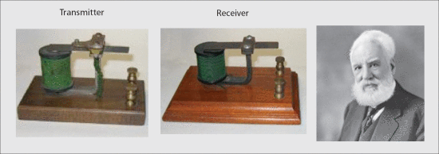
Where did OFDM Come From?
OFDM’s story begins with FDM invented in the 1870s
Telegraph companies began to be interested in transmitting multiple messages at the same time
Alexander Graham Bell (below), Thomas Edison, and Elisha Gray were all big names who worked on the issue

Slide 4
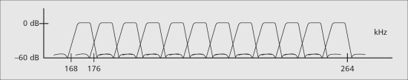
FMD Applied
It was applied on a large scale in the early 1900s with first occurence being military based communication
AT&T then created their own 5 band in 1918 and it became the main way of communicating via telephony
The N2 band was then applied in 1960 using double band modulation and transmitting over 200 miles

Slide 5
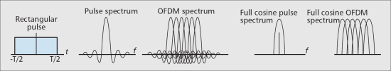
The Drawbacks of FDM and the advent of OFDM
FDM still had its issues
Waste of signal spectrum in guard spaces between subchannels
Complex and separate modulators for each subchannel
The first was alleviated when OFDM was invented allowing non interfering waves to travel the same subchannel

Slide 6
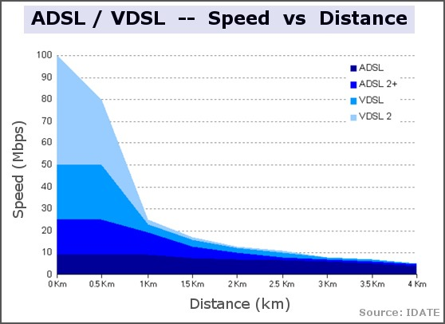
First Major Application of OFDM
OFDM was then applied in ADSL by Bell Labs allowing for higher communication rates and multiple channels for local networks
VDSL was then invented later on after ADSL2+ improving even further on signal band usage and data rates

Slide 7
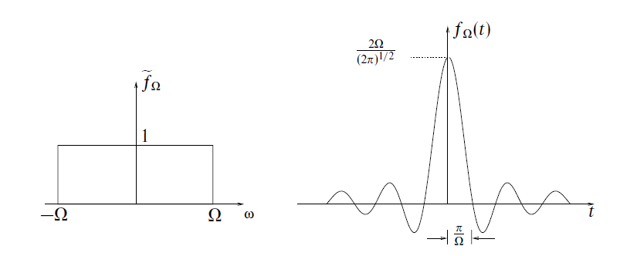
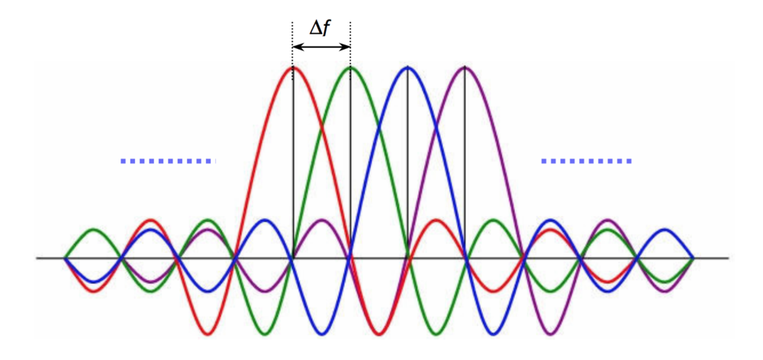
OFDM Basics
Frequency Domain:
Symbols are blocks (rect functions)
Equivalent bandwidths
Combination of multiple blocks in the frequency domain results in no interference at center frequencies.

Slide 8
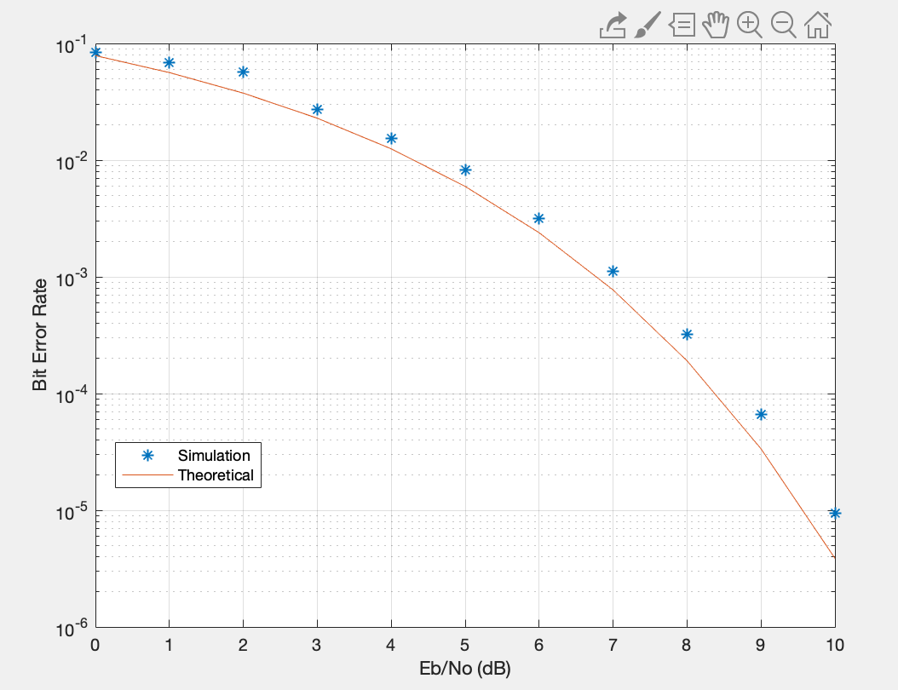
Cyclic prefix Length = 6

Slide 9
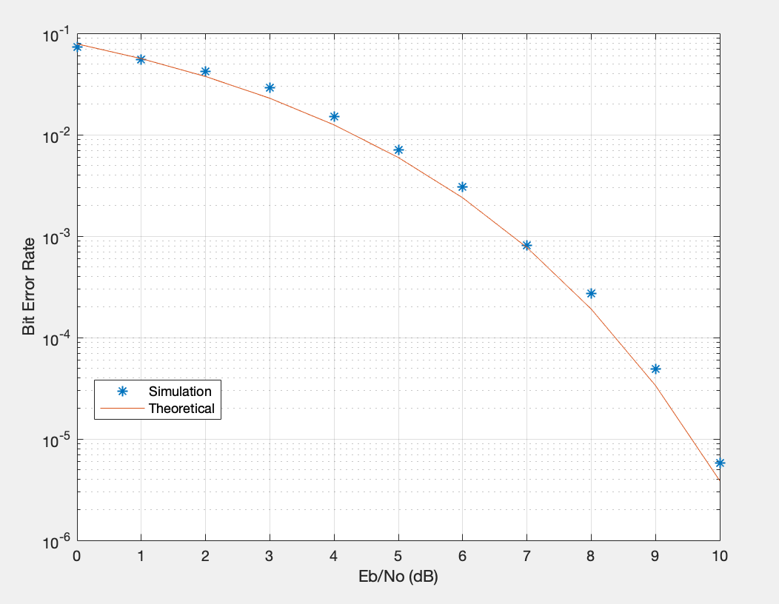
Cyclic prefix Length = 12

Slide 10
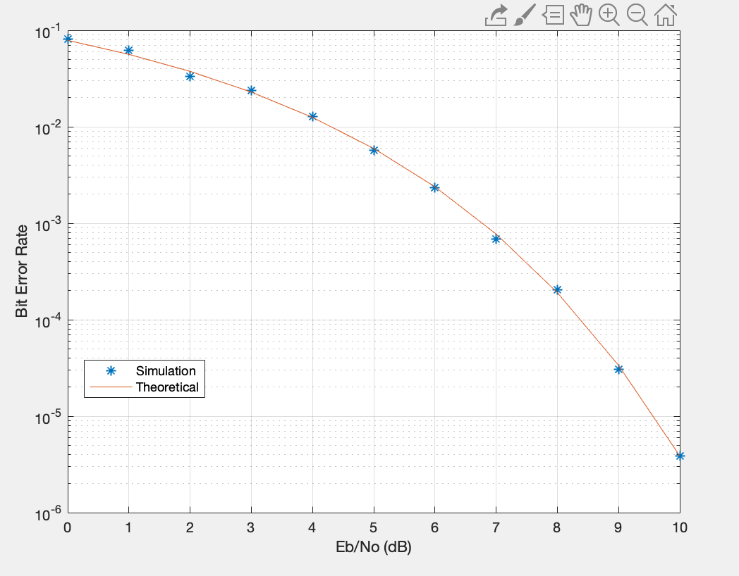
Cyclic prefix Length = 24

Slide 11
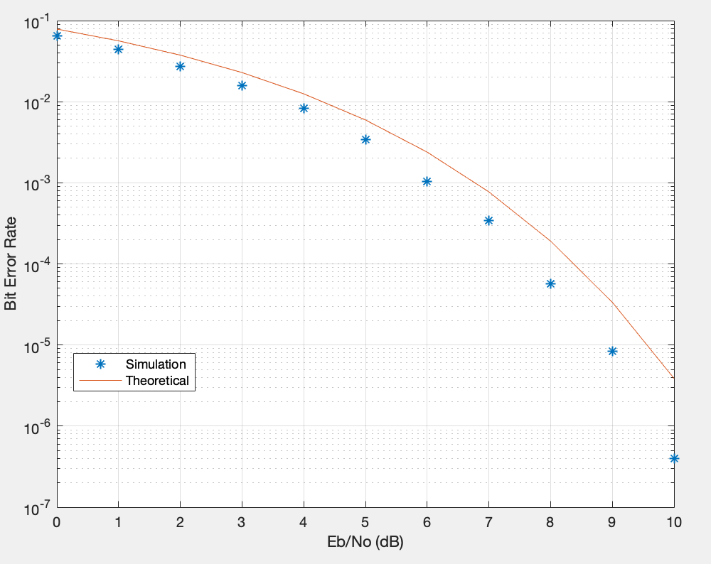
Cyclic prefix Length = 60

Slide 12
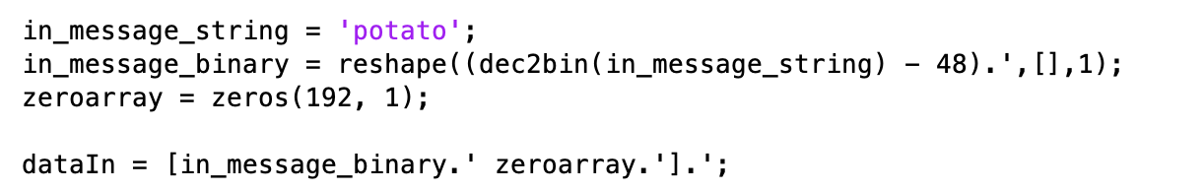
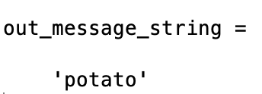
Input/Output Message

Slide 13
Questions?

